Slide 1
HEAP SORT
Heap is a complete binary tree.
Heap sort is always O(n log n).
Heap sort is better in time – critical applications .

Slide 2
There are two types of Heap:
1. Max-heap OR Descending heap:-
A max-heap is a complete binary tree in which the value in each internal node is greater than or equal to the values in the children of that nodes .
2. Min-heap OR Ascending heap:-
A min-heap is a complete binary tree in which the value in each internal node is less than or equal to the values in the children of that nodes .

Slide 3
Working Of Heap Sort
Heap sort is a comparison based sorting algorithm to create a sorted array.
Replace that root with last node of heap tree that keep the root at proper position . i.e. always keep nodes value should be equal to or greater than all its children’s.

Slide 4
Algorithm :
BUILD_HEAP(A).
For i<-lenth(A) down to 2 do
Exchange A[l]<-->A[i]
Heap_size[A]←heap_size[A]-1
heapify(A,i).

Slide 5
HEAPIFY(A , i):
l←left[i]
r←right[i]
If l<=heap_size[A] and A[l]>A[i]
Then largest←l
Else then←i
If r<=heap_size[A] and A[i] >A[largest]
Then largest←R
If largest != I
Then exchange A[i]<--> A[largest]
Heapify (A , largest).

Slide 6
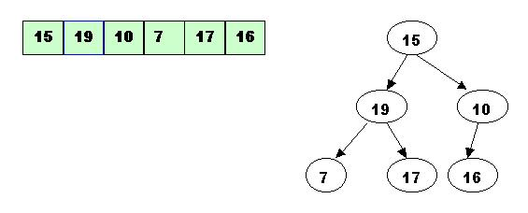
Example
Here is the array: 15, 19, 10, 7, 17, 6
STEP 1: Building the heap tree.

Slide 7
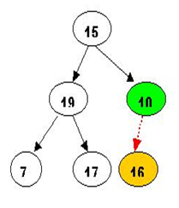
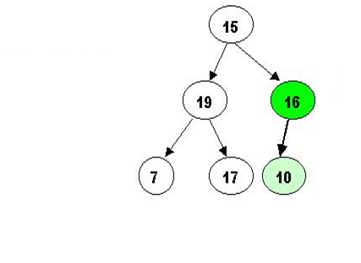
STEP 2: Start with the rightmost node at height 1 - the node at position 3.

Slide 8
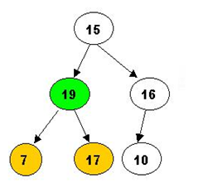
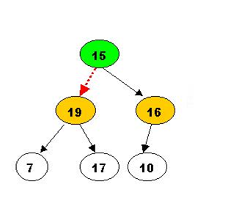
STEP 3: Next comes array[2]. Its children are smaller, so no percolation is needed.

Slide 9
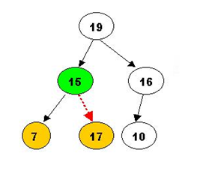
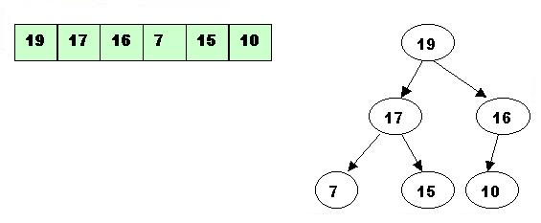
Now the tree is ordered, and the binary heap is built.

Slide 10
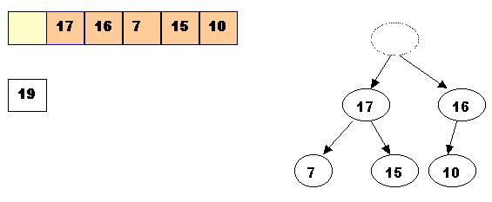
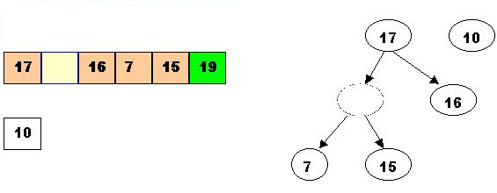
2. Sorting performing delete Max operations
1. Delete the top element 19.
Store 19 in a temporary place. A hole is created at the top
Swap 19 with the last element of the heap.
As 10 will be adjusted in the heap, its cell will no longer be a part of the heap.

Slide 11
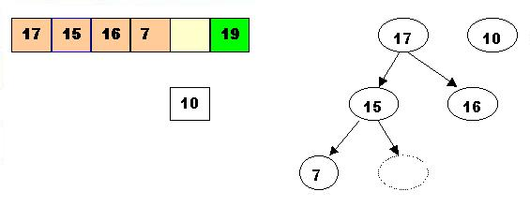
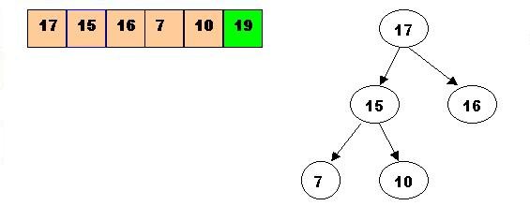
Percolate once more (10 is less that 15, so it cannot be inserted in the previous hole).
Now 10 can be inserted in the hole.

Slide 12
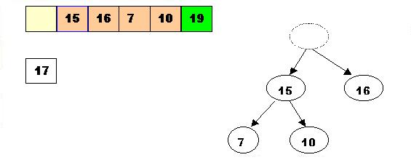
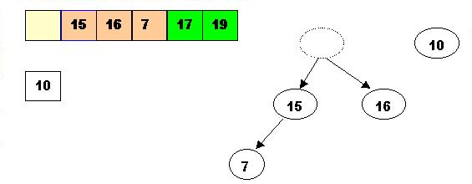
2. Delete Max the top element 17. Store 17 in a temporary place. A hole is created at the top.
Swap 17 with the last element of the heap.
As 10 will be adjusted in the heap, its cell will no longer be a part of the heap.
Instead it becomes a cell from the sorted array

Slide 13
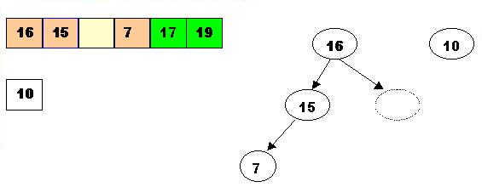
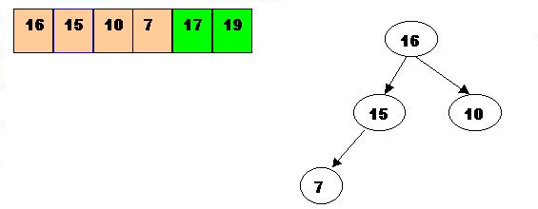
The element 10 is less than the children of the hole, and we percolate the hole down
Insert 10 in the hole

Slide 14
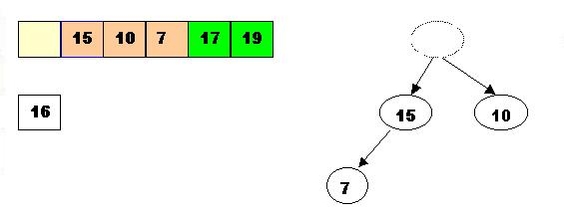
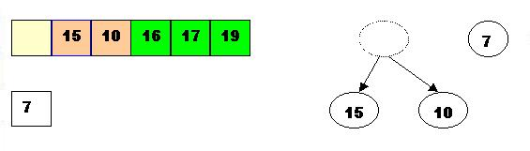
3. Delete Max 16
Store 16 in a temporary place. A hole is created at the top
Swap 16 with the last element of the heap.
As 7 will be adjusted in the heap, its cell will no longer be a part of the heap. Instead it becomes a cell from the sorted array.

Slide 15
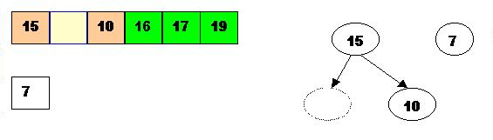
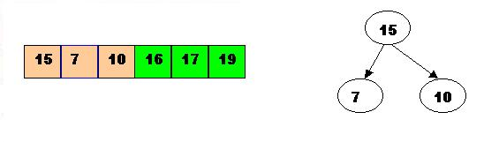
Percolate the hole down (7 cannot be inserted there - it is less than the children of the hole)
Insert 7 in the hole

Slide 16
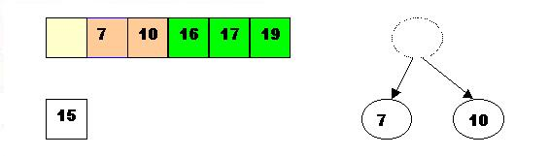
4. Delete Max the top element 15
Store 15 in a temporary location. A hole is created

Slide 17
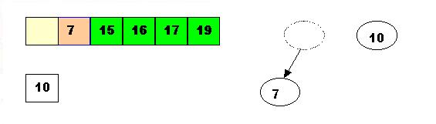
Swap 15 with the last element of the heap.
As 10 will be adjusted in the heap, its cell will no longer be a part of the heap.
Instead it becomes a position from the sorted array.

Slide 18
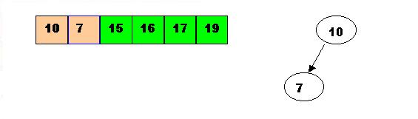
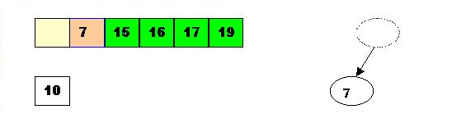
Store 10 in the hole (10 is greater than the children of the hole)
5. Delete Max the top element 10.
Remove 10 from the heap and store it into a temporary location.

Slide 19
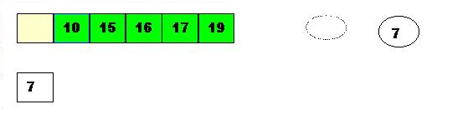


Swap 10 with the last element of the heap.
As 7 will be adjusted in the heap, its cell will no longer be a part of the heap. Instead it becomes a cell from the sorted array.
Store 7 in the hole (as the only remaining element in the heap.
7 is the last element from the heap, so now the array is sorted.

Slide 20
END

